Slide 1

Data & Signals (Part 1)
Course Code: COE 3201 Course Title: Data Communication
Dept. of Computer Engineering
Faculty of Engineering
Lecture No: | 5 | Week No: | 5 | Semester:
Lecturer: | DEBRAJ DAS

Slide 2
Lecture Outline
Digital to Digital Conversion
Signal Element vs Data Element
Signal Rate vs Data Rate
Baseline Wandering
DC Component
Synchronization
7. Line Coding:
Unipolar
Polar
Bipolar
Multilevel
Multitransition

Slide 3
Digital to Digital Conversion
Digital to digital conversion is the way of representing digital data by using digital signals. The conversion involves three techniques: line coding, block coding, and scrambling.
Line coding is always needed. We will mainly discuss line coding in this lecture.
Block coding and scrambling may or may not be needed.

Slide 4
Signal Element vs Data Element
Signal element
The shortest unit (timewise) of a digital signal.
Data element
The smallest entity that can represent a piece of information: this is bit.
In other words
Data elements are what we need to send.
Signal elements are what we can send.

Slide 5
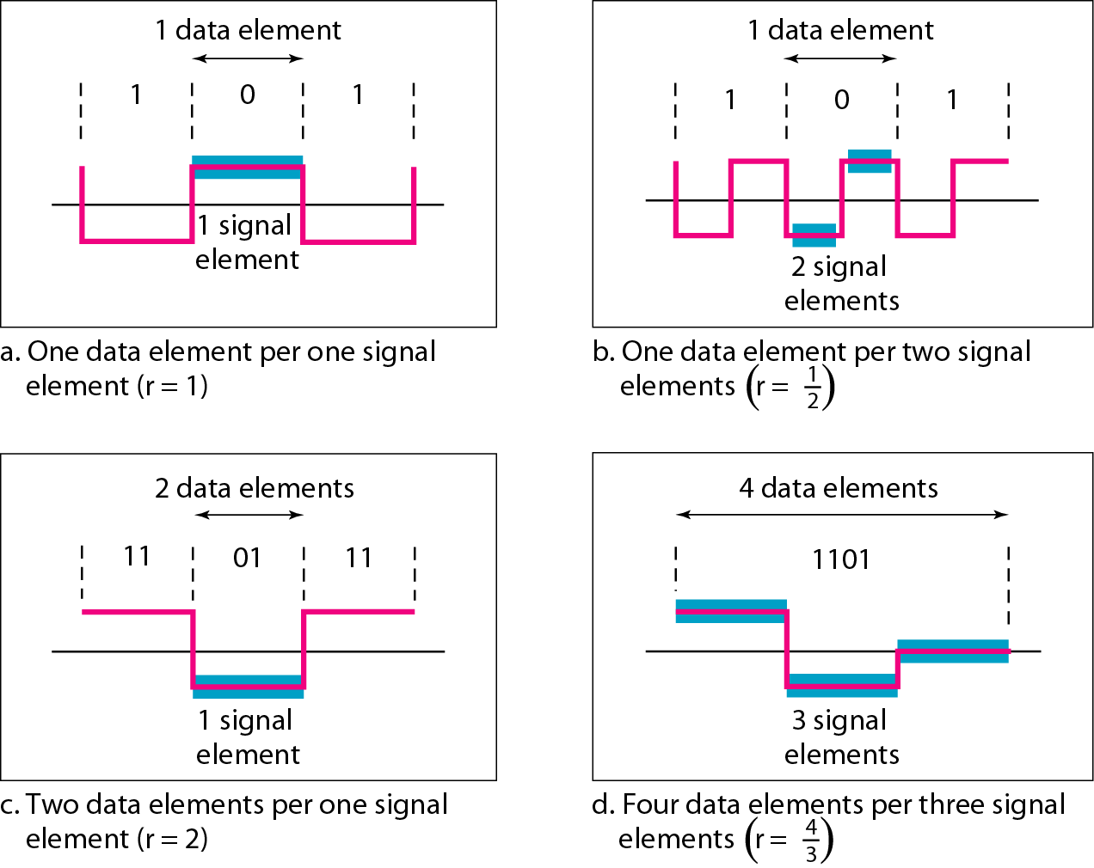
Signal Element vs Data Element

Slide 6
Signal Rate vs Data Rate
Signal rate
The number of signal elements sent in 1s
The unit is baud
Data rate
The number of data elements (bits) sent in 1s
The unit is bits per second (bps)
Relationship between data rate and signal rate
S = c × N × ¹
baud
r
S: signal rate (baud), c: case factor, N: data rate (bps), r: data elements per signal elements

Slide 7
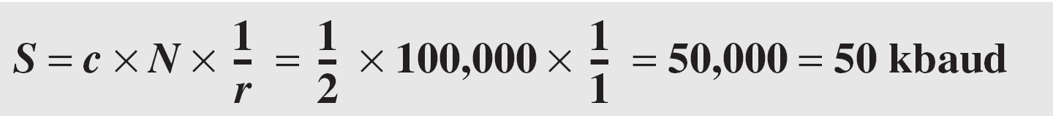
Signal Rate vs Data Rate
Problem:
A signal is carrying data in which one data element is encoded as one signal element (r = 1). If the bit rate is 100 kbps, what is the average value of the baud rate if c is assumed to vary between 0 and 1?
Solution:
We assume that the average value of c is 1/2 . The baud rate is then

Slide 8
Signal Rate vs Data Rate
Problem:
The maximum data rate of a channel is N_{max} = 2 × B × log₂ L (defined by the Nyquist formula). Does this agree with the previous formula for N_{max}?
Solution:
A signal with L levels can carry log₂L bits per level. If each level corresponds to one signal element and we assume the average case (c = 1/2), then we have

Slide 9
Baseline Wandering
In decoding a digital signal, the receiver calculates a running average
of the received signal power.
This average is called the baseline.
The incoming signal power is evaluated against this baseline to determine the value of the data element.
A long string of 0s or 1s can cause a drift in the baseline (baseline wandering) and make it difficult for the receiver to decode correctly.
A good line coding scheme needs to prevent baseline wandering.

Slide 10
DC Component
When the voltage level in a digital signal is constant for a while, the spectrum creates very low frequencies (results of Fourier analysis).
These frequencies around zero, call DC (direct-current) components, present problems for a system that cannot pass low frequencies or a system that uses electrical coupling (via a transformer).
For example, a telephone line cannot pass frequencies below 200 Hz.

Slide 11
Synchronization
To correctly interpret the signals received from the sender, the receiver’s bit intervals must correspond exactly to the sender’s bit intervals. If the receiver clock is faster or slower, the bit intervals are not matched, and the receiver might misinterpret the signals.
Self-synchronization
Digital signal includes timing information in the data being transmitted.
This can be achieved if there are transitions in the signal that alert
the receiver to the beginning, middle, or end of the pulse.

Slide 12
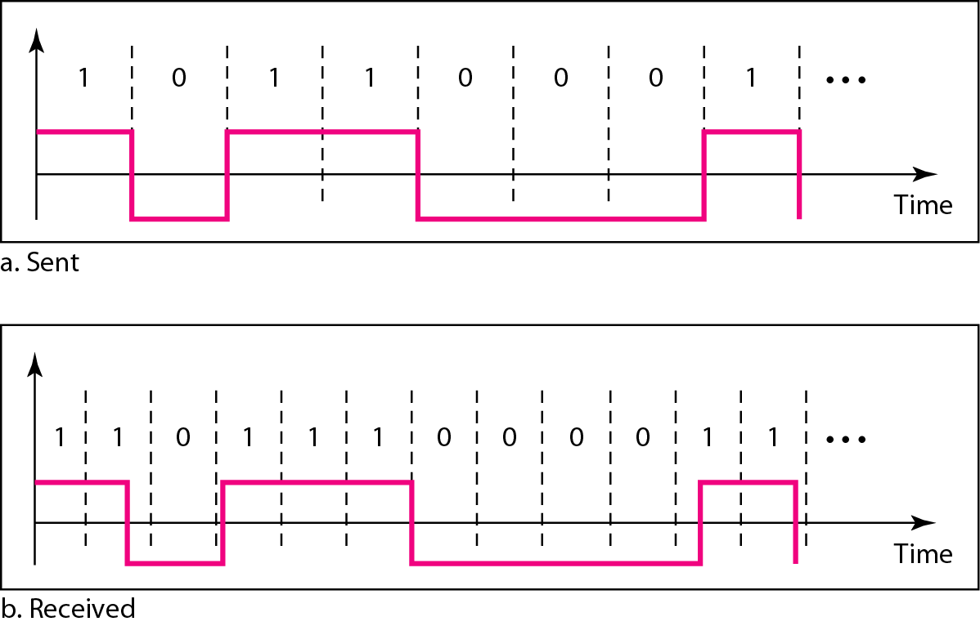
Effect of Lack of Synchronization

Slide 13
Effect of Lack of Synchronization
Problem:
In a digital transmission, the receiver clock is 0.1 percent faster than the sender clock. How many extra bits per second does the receiver receive if the data rate is 1 kbps? How many if the data rate is 1 Mbps?
Solution:
At 1 kbps, the receiver receives 1001 bps instead of 1000 bps.
At 1 Mbps, the receiver receives 1,001,000 bps instead of 1,000,000 bps.

Slide 14
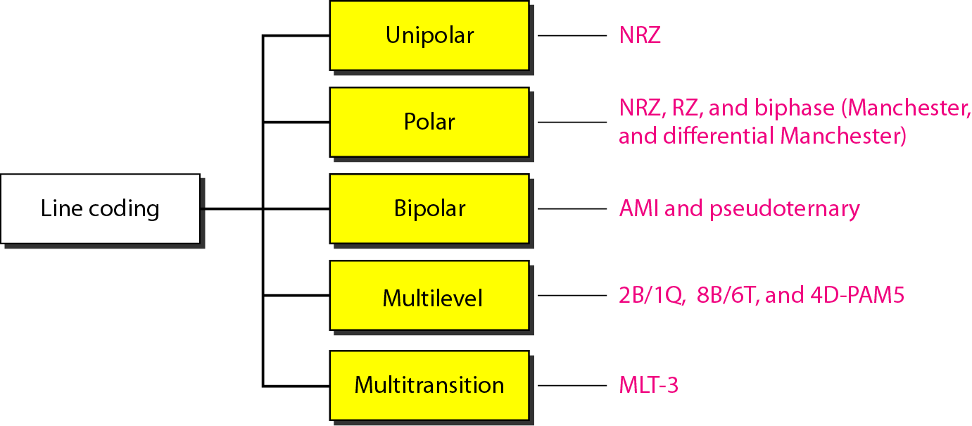
Line Coding
Line coding schemes

Slide 15
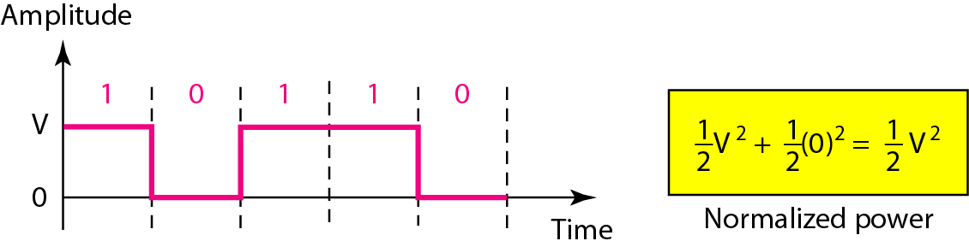
Unipolar
Non-Return to Zero
It is called NRZ because the signal does not return to zero at the middle of the bit.

Slide 16
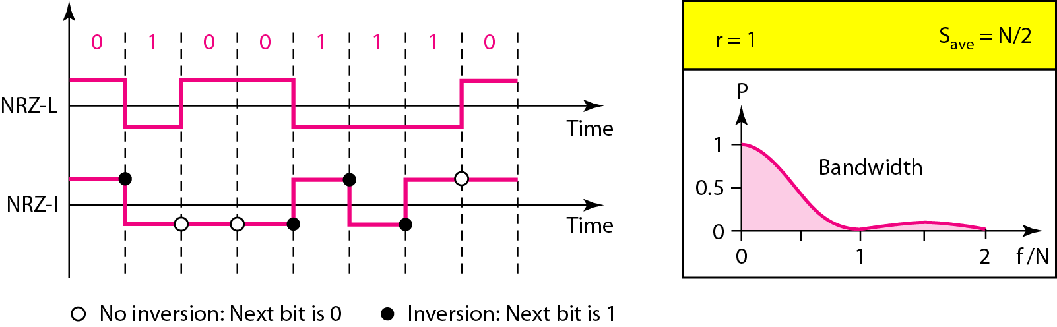
Polar
NRZ-L (NRZ-Level), NRZ-I (NRZ-Invert)

Slide 17
Polar: NRZ-L (NRZ-Level), NRZ-I (NRZ-Invert)
In NRZ-L the level of the voltage determines the value of the bit.
In NRZ-I the inversion or the lack of inversion determines the value of the bit.
NRZ-L and NRZ-I both have an average signal rate of N/2 Baud.
NRZ-L and NRZ-I both have a DC component problem.

Slide 18
Polar: NRZ-L (NRZ-Level), NRZ-I (NRZ-Invert)
Problem:
A system is using NRZ-I to transfer 10-Mbps data. What are
the average signal rate and minimum bandwidth?
Solution:
The average signal rate, S = N/2 = 5000 kbaud
The minimum bandwidth for this average baud rate, B_{min} = S = 5000 kHz.

Slide 19
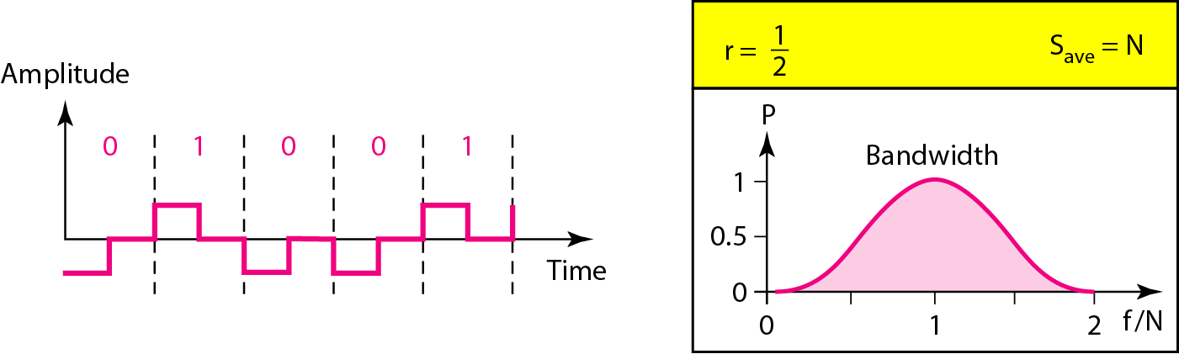
Polar
RZ: Return-to-Zero Scheme

Slide 20
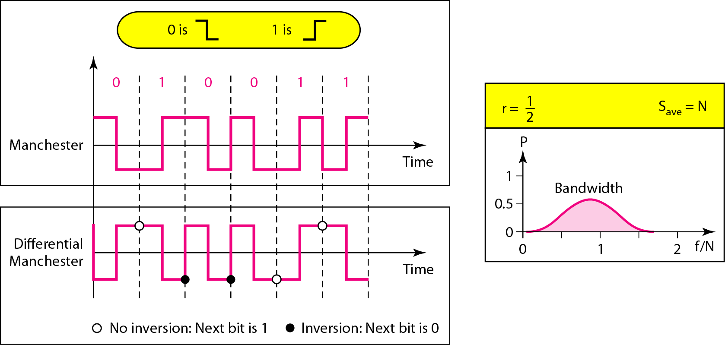
Polar Biphase
Manchester and Differential Manchester Schemes

Slide 21
Manchester and differential Manchester schemes
In Manchester and differential Manchester encoding, the
transition at the middle of the bit is used for synchronization.
The minimum bandwidth of Manchester and differential Manchester is 2 times that of NRZ.

Slide 22
Bipolar Schemes
AMI and Pseudoternary
Bipolar encoding (sometimes called multilevel binary)
Three voltage levels: positive, negative, and zero
Two variations of bipolar encoding
AMI (alternate mark inversion)
0: neutral zero voltage
1: alternating positive and negative voltages
Pseudoternary
1: neutral zero voltage
0: alternating positive and negative voltages
Bipolar schemes have no DC component problem
In bipolar encoding, we use three levels: positive, zero, and negative.

Slide 23
AMI and Pseudoternary
AMI (alternate mark inversion)
The word mark comes from telegraphy and means 1
AMI means alternate 1 inversion
The neutral zero voltage represents binary 0
Binary 1s are represented by alternating positive and negative voltages
Pesudoternary
Same as AMI, but 1 bit is encoded as a zero voltage and the 0 bit is encoded as alternating positive and negative voltages.

Slide 24
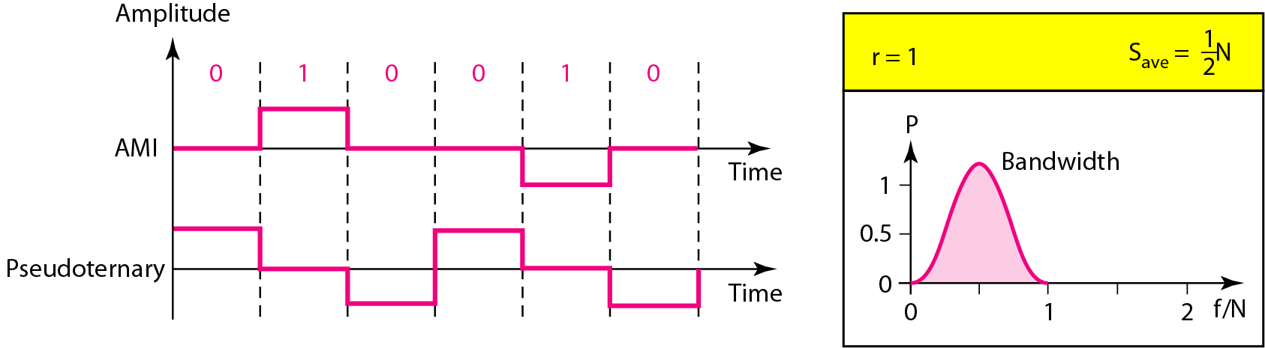
AMI and Pseudoternary

Slide 25
Multilevel Schemes
The desire to increase the data speed or decrease the required
bandwidth has resulted in the creation of many schemes.
The goal is to increase the number of bits per baud by encoding a
pattern of m data elements into a pattern of n signal elements.
Different types of signal elements can be allowed for different signal levels.

Slide 26
Multilevel Schemes
If we have L different levels, then we can produce L^{n} combinations of signal patterns.
The data element and signal element relation is
mBnL coding, where m is the length of the binary pattern, B means binary data, n is the length of the signal pattern, and L is the number of levels in the signaling.
B (binary, L=2), T (tenary, L=3), and Q (quaternary, L=4).

Slide 27
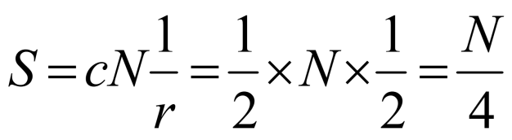
Multilevel: 2B1Q scheme
2B1Q (two binary, one quaternary)
m=2, n=1, and L=4
The signal rate (baud rate)
2B1Q is used in DSL (digital subscriber line) technology to provide a high-speed connection to the Internet by using subscriber telephone lines.

Slide 28

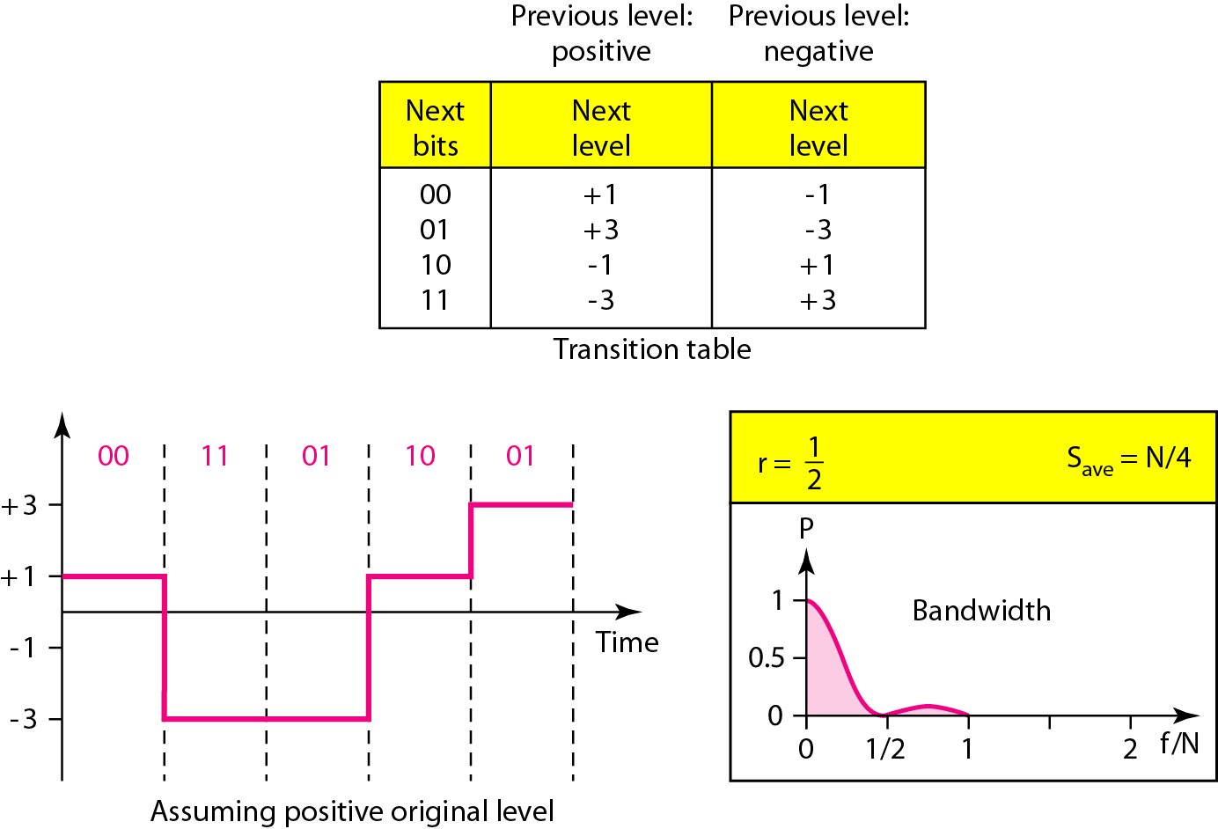
Multilevel: 2B1Q scheme

Slide 29
Multilevel: 8B6T scheme
This code is used with 100BASE-4T cable.
Encode a pattern of 8 bits as a pattern of 6 signal elements,
where the signal has three levels (ternary).
2⁸=256 different data patterns and 3⁶=729 different signal patterns. (The mapping is shown in Appendix D.)
There are 729-256=473 redundant signal elements that provide synchronization and error detection.
Part of the redundancy is also used to provide DC (direct- current) balance.

Slide 30
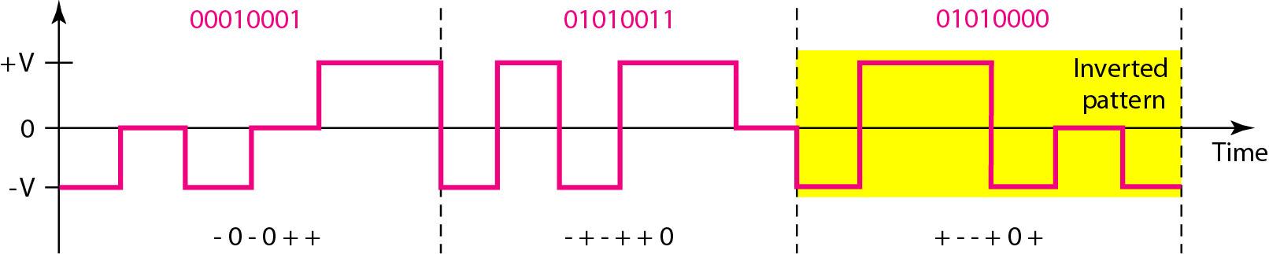
Multilevel: 8B6T scheme
❖ + (positive signal), - (negative signal), and 0 (lack of signal) notation.
To make whole stream DC-balanced, the sender keeps track
of the weight
Invert - + + - 0 - = -1

Slide 31
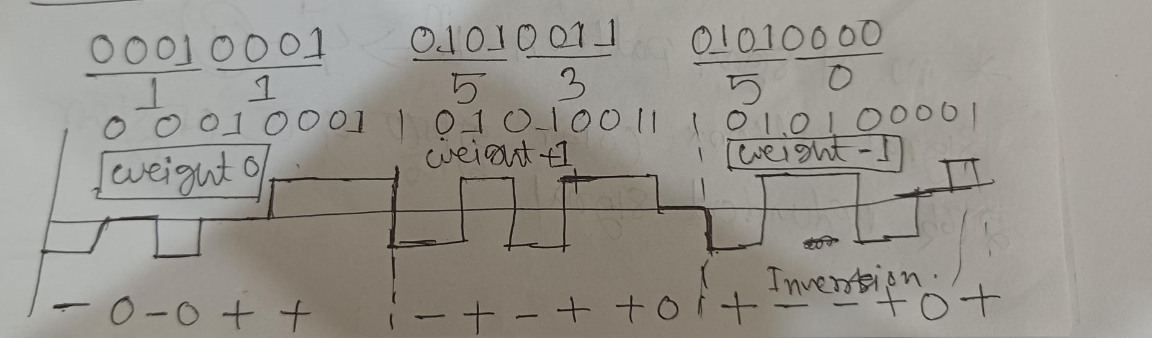
8B6T
DATA | CODE | DATA | CODE
00 | -+00-+ | 2A | +0+-0-
11 | -0-0++ | 50 | +--+0+
OA | 0-++-0 | 53 | -+-++0
00010001 01010011 01010000

Slide 32
Multiline Transmission: MLT-3
Three levels (+V, 0, and –V) and three transition rules to move the levels
If the next bit is 0, there is no transition
If the next bit is 1 and the current level is not 0, the
next level is 0.
If the next bit is 1 and the current level is 0, the next level is the opposite of the last nonzero level.

Slide 33
Multiline Transmission: MLT-3
Why do we need to use MLT-3?
The signal rate for MLT-3 is one-fourth the bit rate (N/4).
This makes MLT-3 a suitable choice when we need to send 100 Mbps on a copper wire that cannot support more than 32 MHz (frequencies above this level create electromagnetic emission).

Slide 34
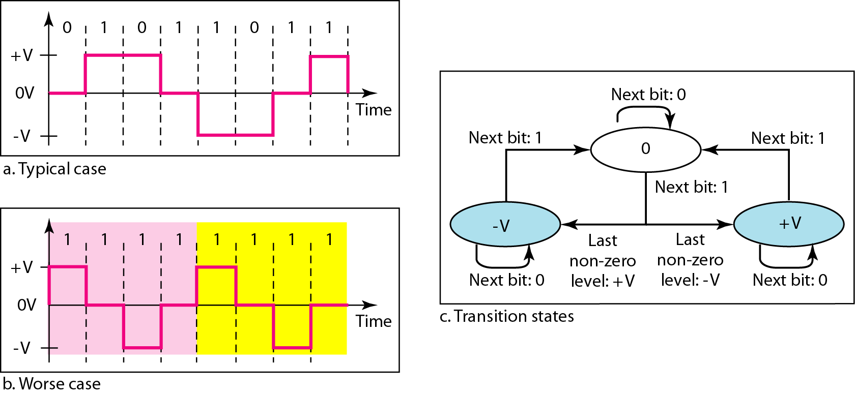
Multiline Transmission: MLT-3

Slide 35
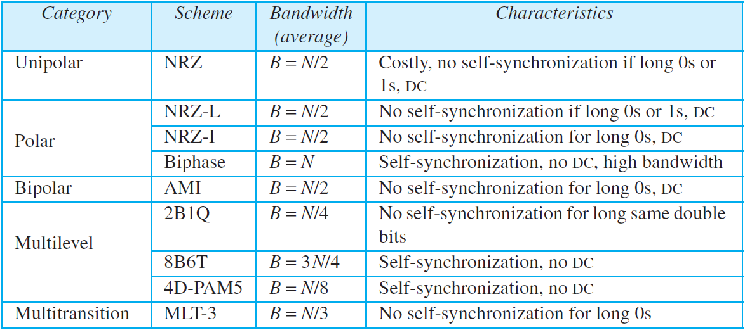
Summary

Slide 36
Books
1. Forouzan, B. A. "Data Communication and Networking. Tata McGraw." (2005).

Slide 37
References
Prakash C. Gupta, “Data communications”, Prentice Hall India Pvt.
William Stallings, "Data and Computer Communications”, Pearson
Forouzan, B. A. "Data Communication and Networking. Tata McGraw." (2005).

